Slide 1

Working with SSL Certificate

Slide 2
Introduction
SSL (Secure Sockets Layer) is a standard security protocol for establishing a secure connection between the server and the client which is a browser.
Following benefits of using SSL certificate are:-
One can increase their users' and customer's trust in order to enhance the business' growth rapidly.
These certificates help to secure online transactions and customers sensitive information like credit-card/debit-card data, etc.
Signing certificate tends to get a maximum number of downloads and good reviews from users.
For Example:- SSL-secured websites begin with https:// and see a lock icon or green address bar in the browser as below :-

Slide 3
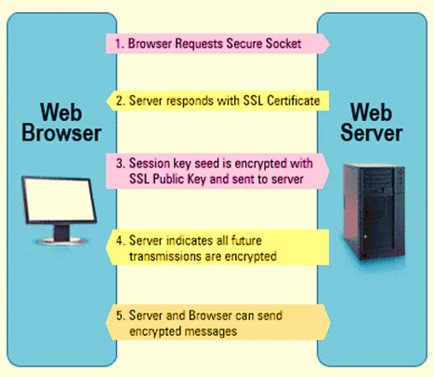
Create Secure Connection using SSL Certificate
Browser sends HTTPS request to the server.
Server sends a copy of its SSL certificate to the browser for identification to Browser to prove that it is trusted.
Each Browser has its own list of Trusted CA's. Browser checks the certificate root against its list of trusted CAs and that the certificate is unexpired, unrevoked and that the name is valid for the website that it is connecting to.
If the browser trusts the certificate,an encrypted session is created between server and the browser.
Server and Browser can send encrypted messages.

Slide 4
Types of SSL Certificates
Browser and the server use SSL Certificate mechanism to be able to establish a secure connection. This connection involves verification of three types of certificates.
Root
Intermediate
Server Certificate

Slide 5
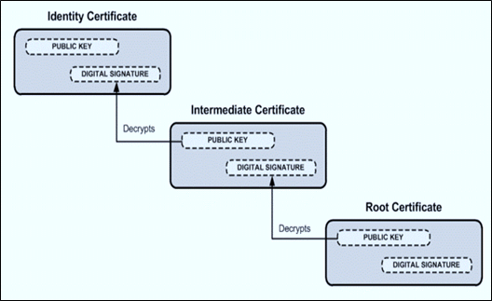
Verification of SSL Certificate
SSL works through a combination of programs and encryption/decryption routine that exist on the web server computer and web server browser.
SSL certificate basically contains below information:-
Subject which is the identity of the website owner.
Validity information- a public and a private key.
The Private and public key are two uniquely related cryptographic keys (numbers). Whatever is encrypted by a public key may only be decrypted by a private key.

Slide 6
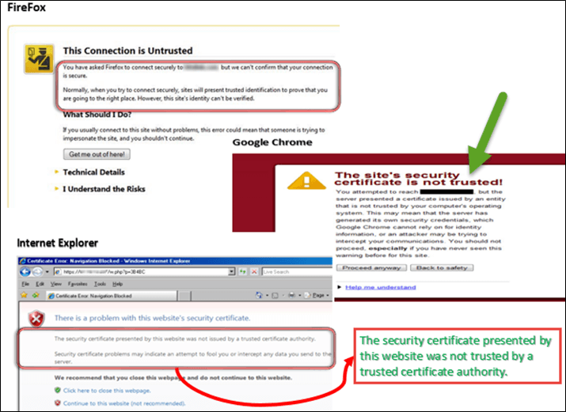
Types of SSL Certificate Error
The types of error due to certificate in different browsers are:-
FireFox - This connection is untrusted
Google Chrome -This site security is not trusted
Internet Explorer ( IE) - This security certificate presented by this website was not trusted by a trusted certificate authority (CA)

Slide 7
SSL Certificate Error Handling in Firefox
Selenium Web driver use desired capabilities for handling SSL certificate error in Firefox following steps are:-
Step 1) Create a new firefox profile say “myProfile” .
Step 2) Now access myProfile and create the FirefoxProfile object.
Step 3) set "setAcceptUntrustedCertificates" and "setAssumeUntrustedCertificateIssuer" properties in the Fire Fox profile.
Step 4) Use the FireFox profile in the FireFox driver object.
ProfilesIni prof = new ProfilesIni()
FirefoxProfile ffProfile= prof.getProfile ("myProfile")
ffProfile.setAcceptUntrustedCertificates(true) ffProfile.setAssumeUntrustedCertificateIssuer(false)
WebDriver driver = new FirefoxDriver (ffProfile)

Slide 8
SSL Certificate Error Handling in Chrome
Selenium Web driver use desired capabilities for handling SSL certificate error in chrome following code are:-
DesiredCapabilities handlSSLErr = DesiredCapabilities.chrome ()
handlSSLErr.setCapability (CapabilityType.ACCEPT_SSL_CERTS, true)
WebDriver driver = new ChromeDriver (handlSSLErr);

Slide 9
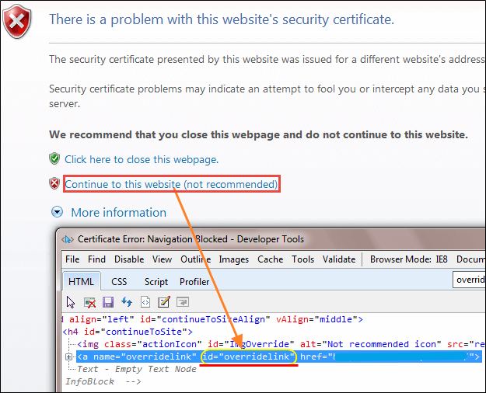
SSL Certificate Error Handling in IE
There are two methods for handling SSL Certificate Error in IE mention below:-
Method 1:-
click the link "Continue to this website (not recommended)“ and view the ID in HTML mode.
driver.navigate ().to ("javascript:document.getElementById('overridelink').click()");

Slide 10
Method 2:-
Selenium Web driver use desired capabilities for handling SSL certificate error in IE following code are:-
DesiredCapabilities capabilities = new DesiredCapabilities();
capabilities.setCapability(CapabilityType.ACCEPT_SSL_CERTS, true);
System.setProperty("webdriver.ie.driver","IEDriverServer.exe");
WebDriver driver = new InternetExplorerDriver(capabilities);

Slide 11
Covered Till Now
SSL (Secure Sockets Layer) is a standard security protocol for establishing secure connection between the server and the client
Browser and the server use SSL Certificate mechanism to be able to establish a secure connection.
SSL works through a combination of programs and encryption/decryption routine that exist on the web server computer and web server browser.
When secure connection is not established between the server and client due to certificate SSL certificate error will occur
Need to adjust script in such a way that it will take care of SSL Exception/error by itself through Selenium Web driver.

Slide 12
Thanks

